Slide 1

Home-Made Weather Station
This is a project overview for module S3-EE1953 - Engineering Design
Department of Electrical Engineering
University of Moratuwa
Page 1

Slide 2
Table of Contents Page No.
Project Description .................................................................................................. 3
Sensors and Components & their Specifications ................................................ 5
Software used ............................................................................................................ 7
Block Diagram of Project ....................................................................................... 8
Circuit Design of the Project .................................................................................. 9
Arduino Code ........................................................................................................... 10
Presentation Video ................................................................................................... 14
VAWT ......................................................................................................................... 15
IoT (ThingSpeak) Output Results .......................................................................... 17
Sample Testing and results ....................................................................................... 18
Expected Budget ....................................................................................................... 19
Timeline ...................................................................................................................... 20
Group Members ........................................................................................................ 21
Thank you ................................................................................................................... 22
Page 2

Slide 3

Project Description
We introduce a small device using Arduino module to monitor the environmental parameters such as temperature, humidity and air pressure and update the collected data (weather statistics) to the cloud storage.
It can be used
by farmers for agricultural purposes
by fishermen for marine fields
for some utility companies to estimate the demands
by students for simple practical sessions in school laboratories
Image Reference : https://www.pinterest.com/pin/1151795673420402350/
Page 3

Slide 4
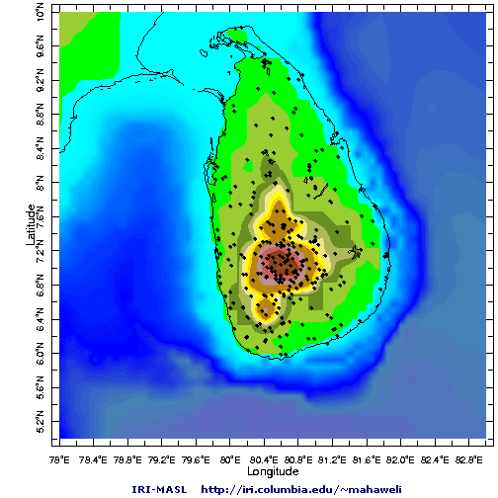
Project Description (Continued...)
We are planning to implement this system through having the device as a small box. And we can put these boxes in multiple places (each district) and able to monitor the weather all over Sri Lanka.
Image reference : https://tropicalclimate.org/~mahaweli/RiverBasinMahaweli/climate.html
Page 4

Slide 5
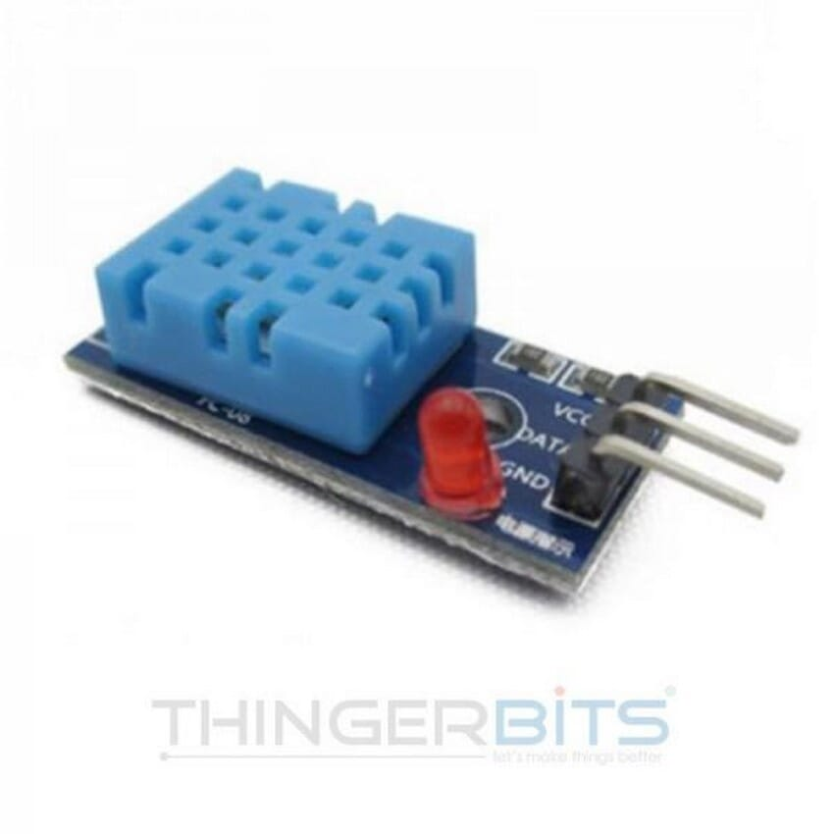
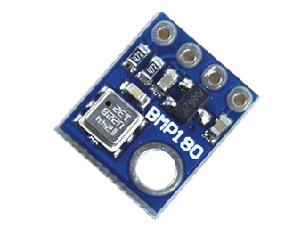
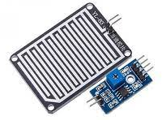
Sensors and Components & their Specifications
Image Reference : https://www.daraz.lk/products/dht11-humidity-and-temperature-sensor-for-arduino-i104749069.html
Image Reference : https://microchip.lk/product/gy-68-bmp180-digital-barometric-pressure-sensor-board-module/
Image Reference : https://www.daraz.lk/products/rain-drop-sensor-module-for-arduino-i104745215.html
Sensor : Humidity and Temperature Module
Specification Type : DHT11
Sensor : Digital Barometric Pressure Module
Specification Type : GY 68 - BMP180
Sensor : Rain Drop Module
Specification Type : YL 83
Page 5

Slide 6
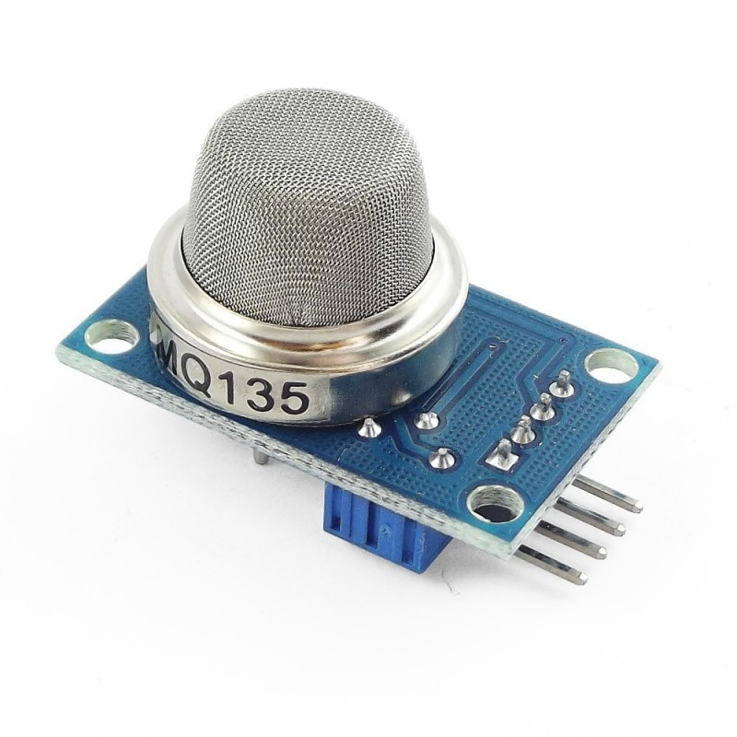
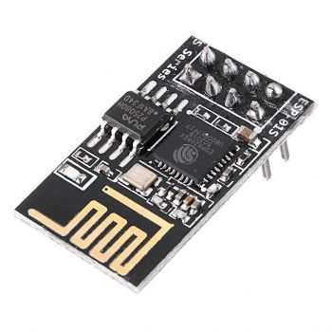
Sensors and Components & their Specifications (Continued...)
https://nilambaraelectronics.com/product/mq-135-air-quality-detection-gas-sensor-module/
https://grobotronics.com/esp8266-wifi-module.html?sl=en
Sensor : Air Quality Detection module
Specification Type : MQ 135
Sensor : ESP8266 Wi-Fi module
Specification Type :
Part Number - ESP8266-01
Page 6

Slide 7



Software
Arduino
For handling the sensor data
Proteus Design Suite
For the automation and simulation of the circuit
ThingSpeak IoT
To communicate with internet enabled devices.
Image Reference : https://commons.wikimedia.org/wiki/File:Arduino_Logo.svg
Image Reference : https://www.labcenter.com/
Image Reference : https://ww2.mathworks.cn/hardware-support/thingspeak.html
Page 7

Slide 8
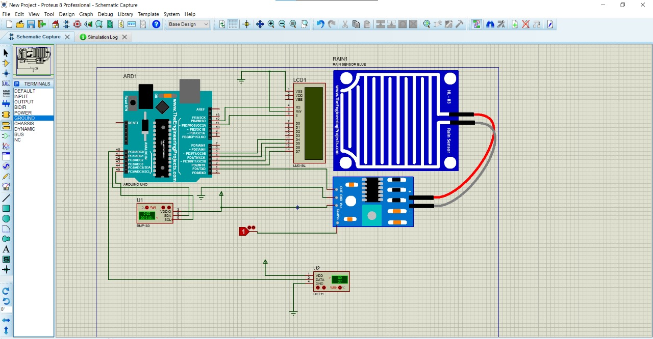
Circuit Design of the Project
Note :
The Design at the left is sketched using Proteus 8 Professional Software
Page 9

Slide 9
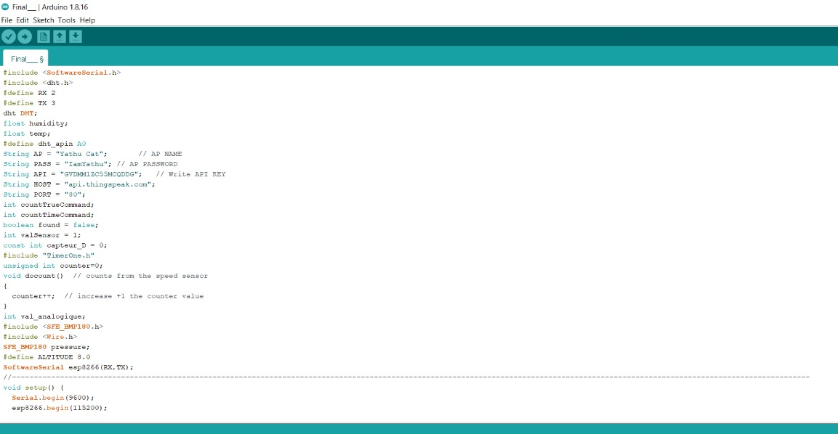
Arduino Code - 1
Page 10

Slide 10
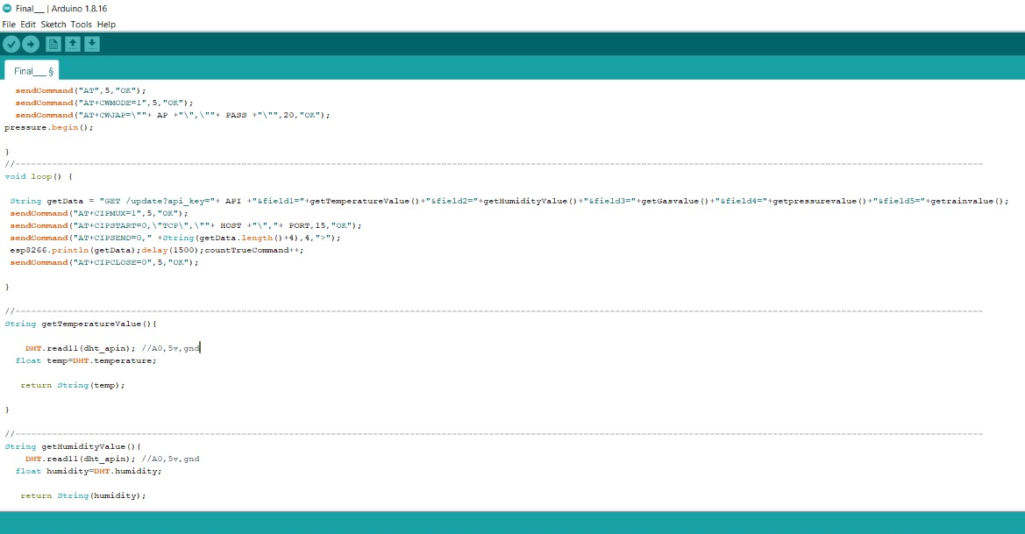
Arduino Code - 2
Page 11

Slide 11
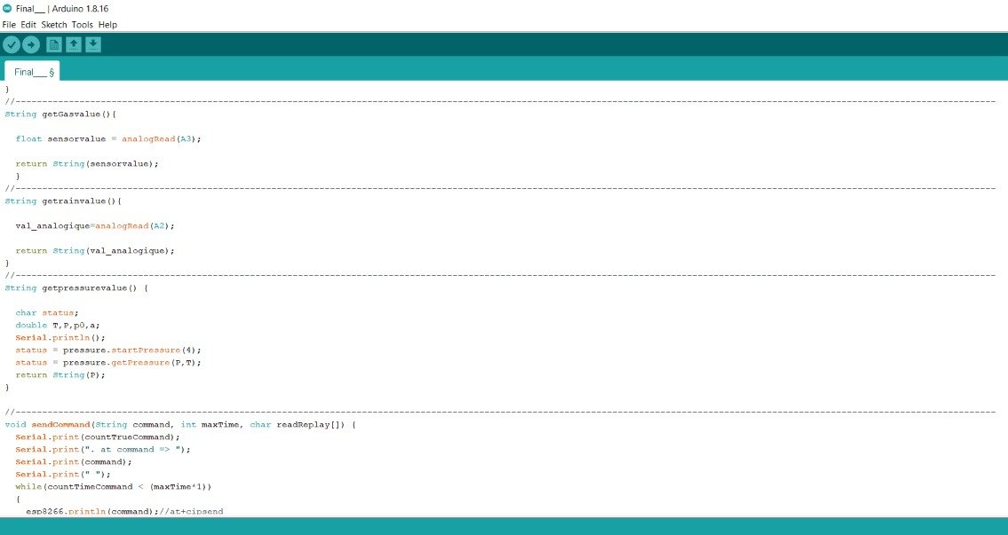
Arduino Code - 3
Page 12

Slide 12
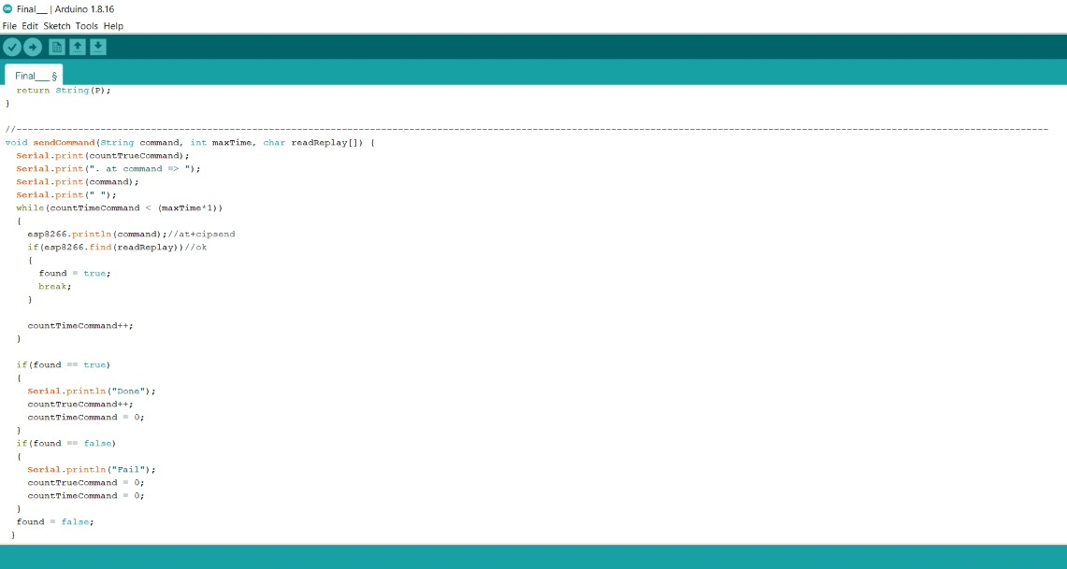
Arduino Code - 4
Page 13

Slide 13




Block Diagram of the Project
Temperature and Humidity Sensor
Air Pressure Sensor
ThingSpeak
Rain Drop Sensor
Arduino Board
Air Quality Sensor
Sensor
VAWT
Page 8

Slide 14

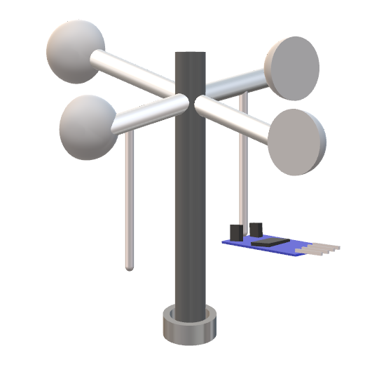
VAWT
(Vertical Axis
Wind Turbine)
We planned to prepare a small-scale wind turbine which can rotate in vertical axis, to monitor the speed of wind.
We had tried several options to measure the rotational speed, but all ended up in vain, leading the project to set aside the VAWT.
Using IR sensor
Using Voltage sensor
Using Ultra sonic sensor
Rough Sketch of Method using IR Sensor
Page 15

Slide 15
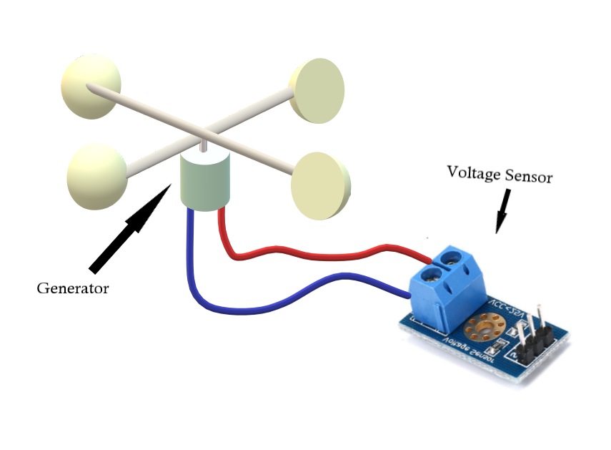
Unavailability of Anemometer which is of High cost. (So, we are unable to do the mapping of windspeeds with the values of sensor data).
The materials we used for VAWT are of high mass and the turbine failed to rotate at enough speed. (So, the readings obtained from the voltage sensor seemed to be very low)(0.06 V to 0.2V).
The system with less-weight materials are not stable.
Rough Sketch of Method using Voltage Sensor
Page 16

Slide 16
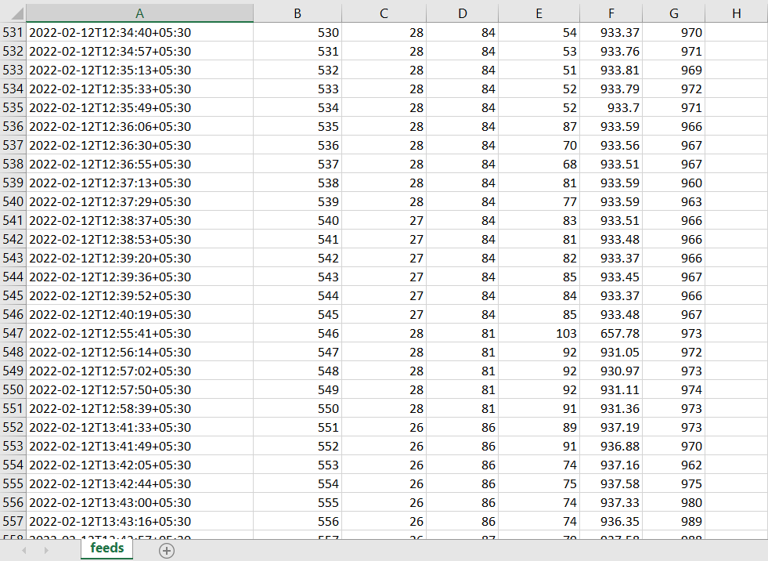
IoT (ThingSpeak) Output Results
The Outputs from each sensor which we obtained in the ThingSpeak platform.
Date and Time
Entry ID
Temperature
Humidity
Air Quality
Pressure
Rain
Page 17

Slide 17
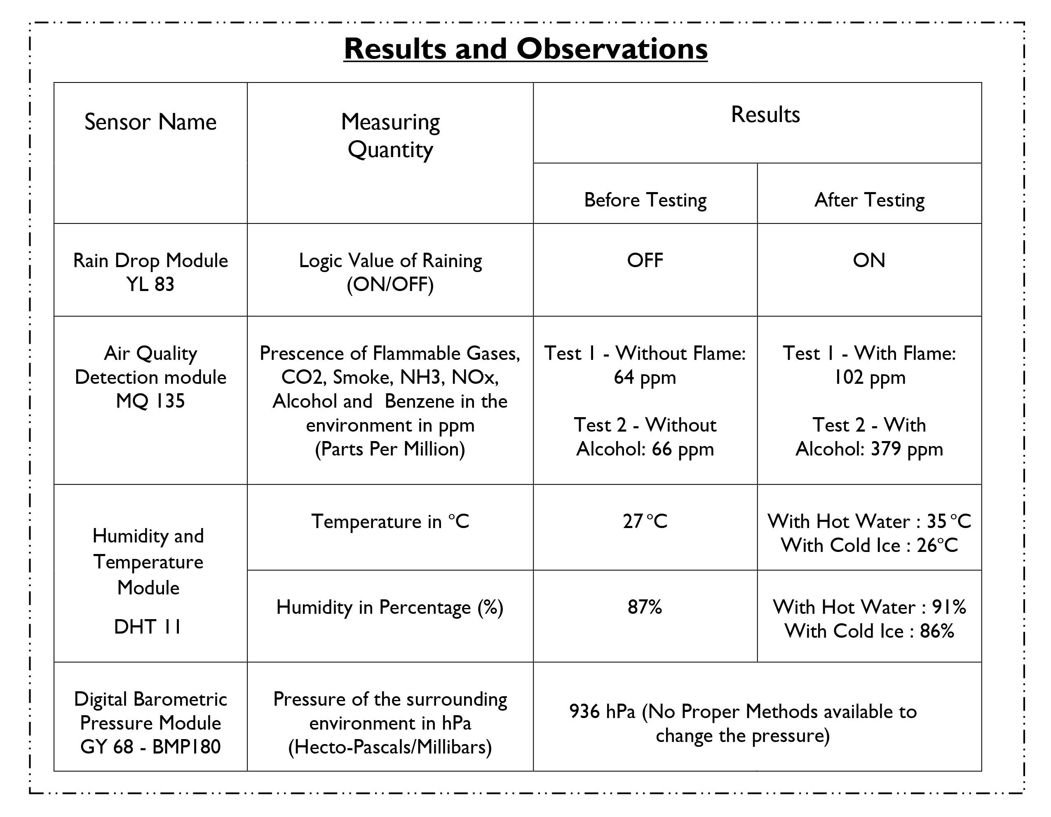
Sample Testing Carried out and its results.
Page 18

Slide 18
Budget
Components | Cost
Temperature & Humidity Sensor | Rs. 350
Barometric Pressure Sensor | Rs. 250
Rain Sensor | Rs. 200
Air quality sensor | Rs. 360
Arduino UNO | Rs. 2000
Wi-Fi Module | Rs. 360
Breadboard | Rs. 250
Jumper Wires | Rs. 350
Courier Services | Rs. 600
Other Expenses | Rs. 680
Total Expense | Rs. 5400
Page 19

Slide 19







Timeline
Weeks 4, 5 and 6
Gathering Sensors and
Implementation
Week 7, 8 and 9
Vertical Axis Wind Turbine Making
Week 3
Project Proposal
Week 10, 11 and 12
Testing and Rechecking Feedbacks
Week 1 and 2
Project topics Research
Week 13 and 14
Final prototype
Page 20

Slide 20
Group Members
Barathraj M. (190091K)
Nanthaluxsan E. (190411U)
Pragalathanan A. (190468A)
Yathunanthanasarma B. (190722A)
Page 21

Slide 21
THANK YOU
Background Image Reference : http://www.freeppt.net/1024x768/april-weather-1026.html
Page 22

